Slide 1
Real-Time Communication Protocols
Protocols

Slide 2
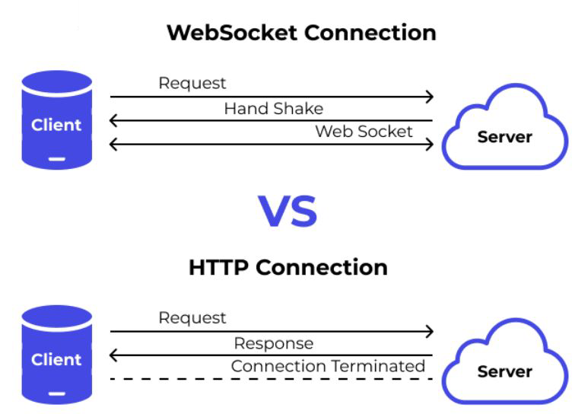
Introduction to Real-Time Communication
Deﬁnition: Real-time communication refers to the continuous exchange of data with minimal latency.
Why real-time is important (e.g., instant chat, live stock updates, multiplayer games).
Challenges of traditional request-response HTTP model.
Traditional HTTP vs. Real-Time Communication
Alternatives to improve real-time data exchange:
  Polling
  WebSockets
  Server-Sent Events (SSE)
  Long Polling

Slide 3
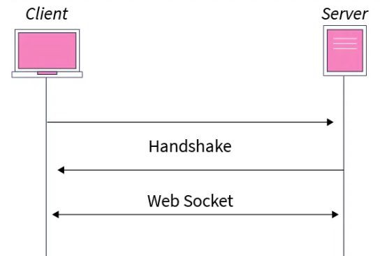
WebSockets: Persistent Full-Duplex Communication
Deﬁnition: WebSockets provide a persistent, full-duplex connection between the client and server over a single TCP connection.
How they work:
  WebSocket handshake using HTTP upgrade request.
    Step 1: Client requests an upgrade to WebSockets
    Step 2: Server accepts and keeps the connection open.
  Connection remains open for continuous data exchange.
  Either client or server can send messages at any time.
    Step 3: Data is exchanged in real-time using frames.
    Step 4: Either party can close the connection when done.

Slide 4

Advantages and use cases of WebSockets
Advantages:
  Persistent connection = lower latency.
  Reduces overhead compared to HTTP polling.
  Eﬃcient for real-time applications.
Use cases:
  Live Chat Applications (WhatsApp, Slack, Discord)
  Stock Market Price Updates (NASDAQ, Robinhood)
  Multiplayer Online Games (Fortnite, Call of Duty)
  Collaborative Tools (Google Docs, Figma)

Slide 5
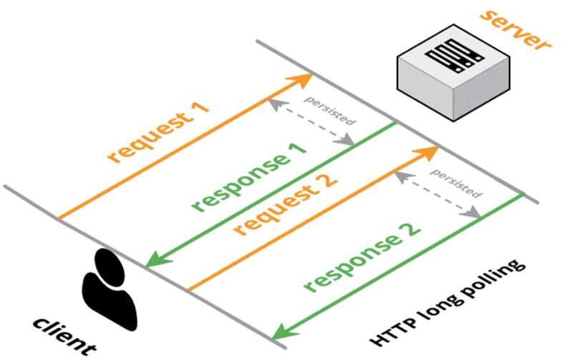
Long Polling: Simulating Real-Time with HTTP
Deﬁnition: A technique where the client sends a request to the server and waits until the server has new data to respond with.
How it diﬀers from regular polling:
Instead of immediate responses, the server holds the request until new data is available.
How Long Polling Works (Step-by-Step)
  Client makes an HTTP request.
  Server holds the request until data is available.
  Server responds with new data.
  Client immediately sends another request.

Slide 6

When to Use WebSockets vs. Long Polling?
Use WebSockets when:
  High-frequency, bi-directional data exchange is needed.
  Low latency is critical (e.g., gaming, chat).
Use Long Polling when:
  WebSockets are not supported or overkill.
  Periodic updates are suﬃcient (e.g., notiﬁcations).
Real-world example:
  Slack: WebSockets for chat.
  Twitter: Long Polling for notiﬁcations.
  Stock Exchanges: WebSockets for real-time data feeds.
  IoT devices: Long Polling for intermittent updates.

Slide 7
Interview Questions
Basic Questions
  What is real-time communication, and why is it important?
  How does WebSockets work, and how does it diﬀer from traditional HTTP?
  Explain the WebSocket handshake process.
  What is long polling, and how does it work?
Intermediate Questions
  What are the advantages of WebSockets over long polling?
  In what scenarios would you prefer long polling over WebSockets?
  How does WebSockets handle connection failures or network interruptions?
  Can you use WebSockets with load balancers? If yes, how?
  What are some challenges of scaling WebSockets in a distributed system?

Slide 8
Summary & Final Takeaways
WebSockets = Persistent, full-duplex communication.
Long Polling = Simulated real-time via HTTP requests.
Choose based on latency needs and infrastructure.
What’s next:
  Modern API Protocols - Beyond REST(gRPC, GraphQL)

